Slide 1
Airbox analysis
劉昱劭 彭敬樺 周才錢 張翔中

Slide 2
outline
Motivation
Data Collection
Data Preprocessing
Data Visualization
Training Results
Conclusion
Group Contribution

Slide 3
Motivation
Air pollution is a serious environmental issue that bothers our homeland nowadays, thousands of sensors are deployed to keep an eye on air quality in real time. Through the observed data in the Airboxes, we try to figure out the evidence that affect air quality, using PM2.5 as the metric.

Slide 4
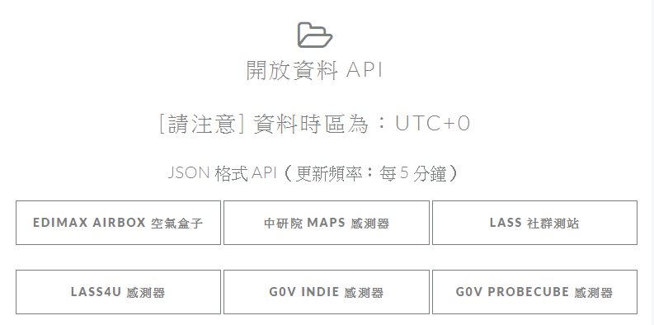
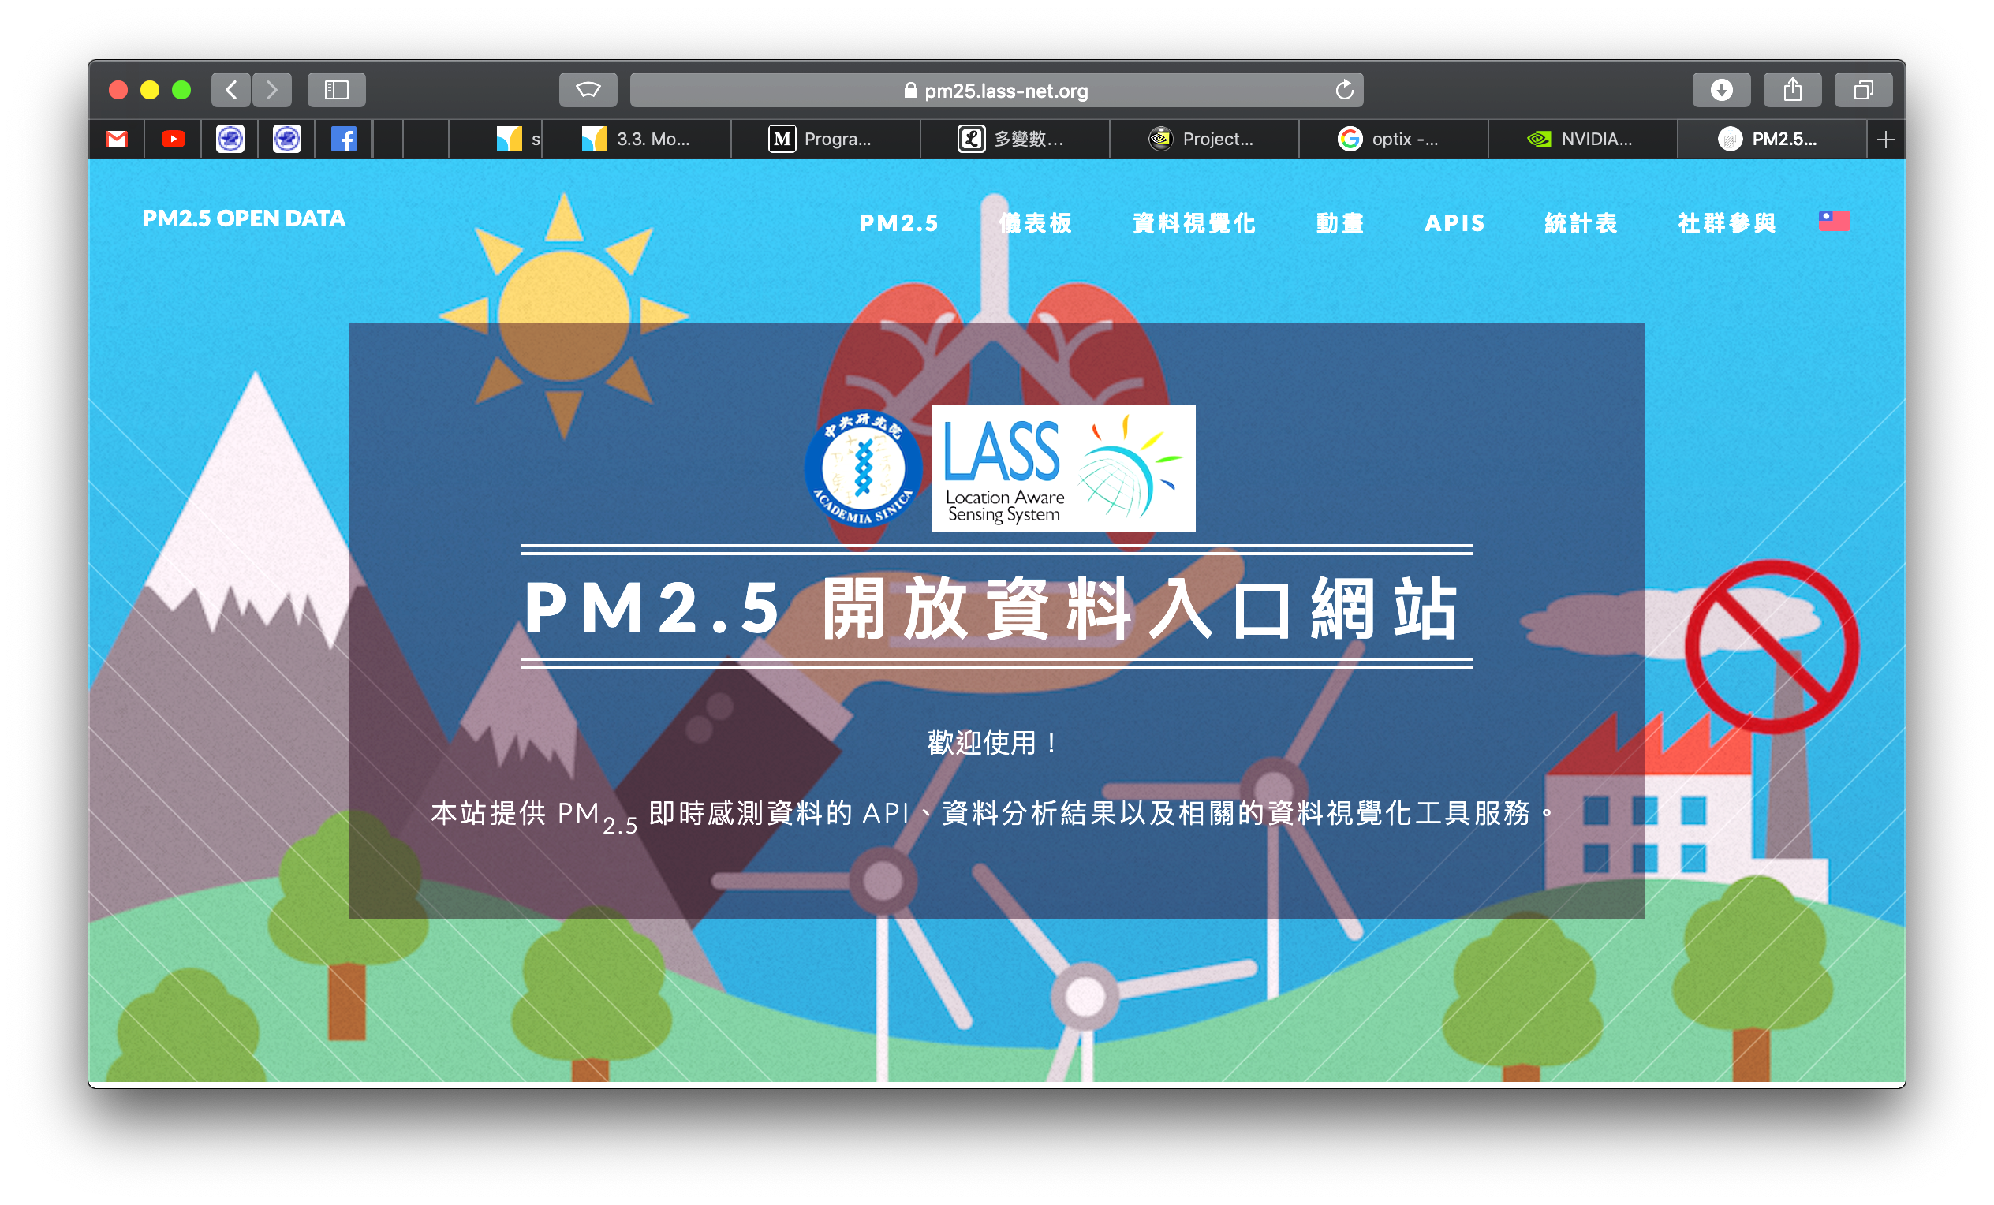
Data Collection
EDIMAX AIRBOX

Slide 5
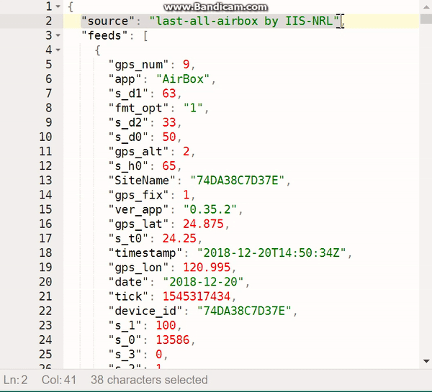
Data Collection
JSON data
Update every 5 minutes

Slide 6
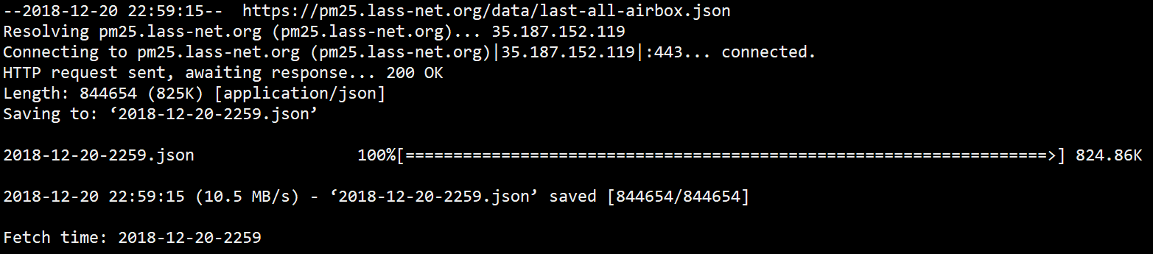

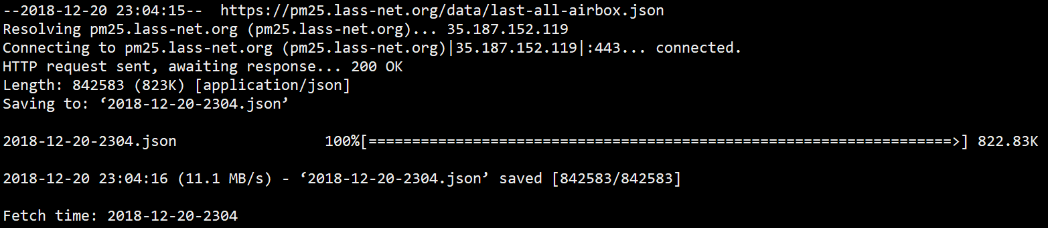
Data Collection
Use shell script to fetch

Slide 7
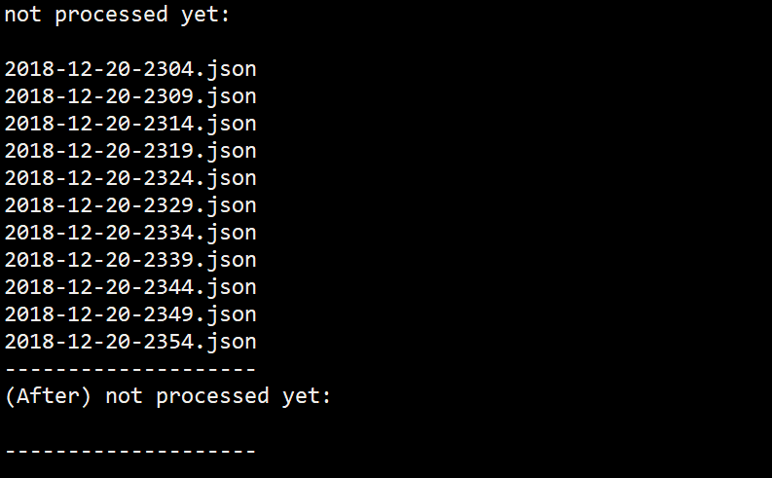
Data Preprocessing
JSON to CSV

Slide 8
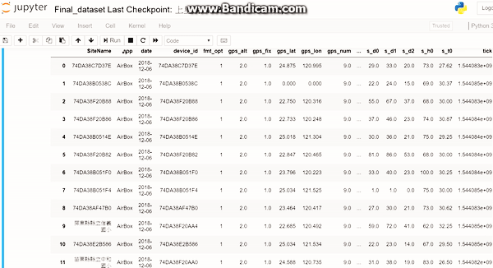
Data Preprocessing (cont.)
JSON to CSV
1800 rows
10 days => over
5 million rows

Slide 9
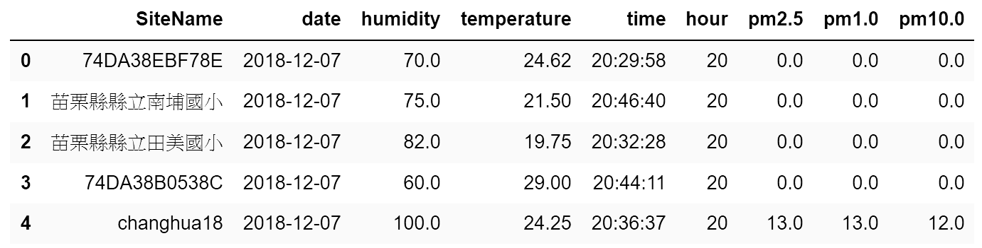
Data Preprocessing (cont.)
Drop useless columns

Slide 10
Data Preprocessing (cont.)
Group data
SiteName > date > hour
multiple rows are averaged within groups
Create new columns
s_d0_b1 / s_d0_b2 / s_d0_b3
averaged PM2.5 in previous 1/2/3 hour(s)

Slide 11
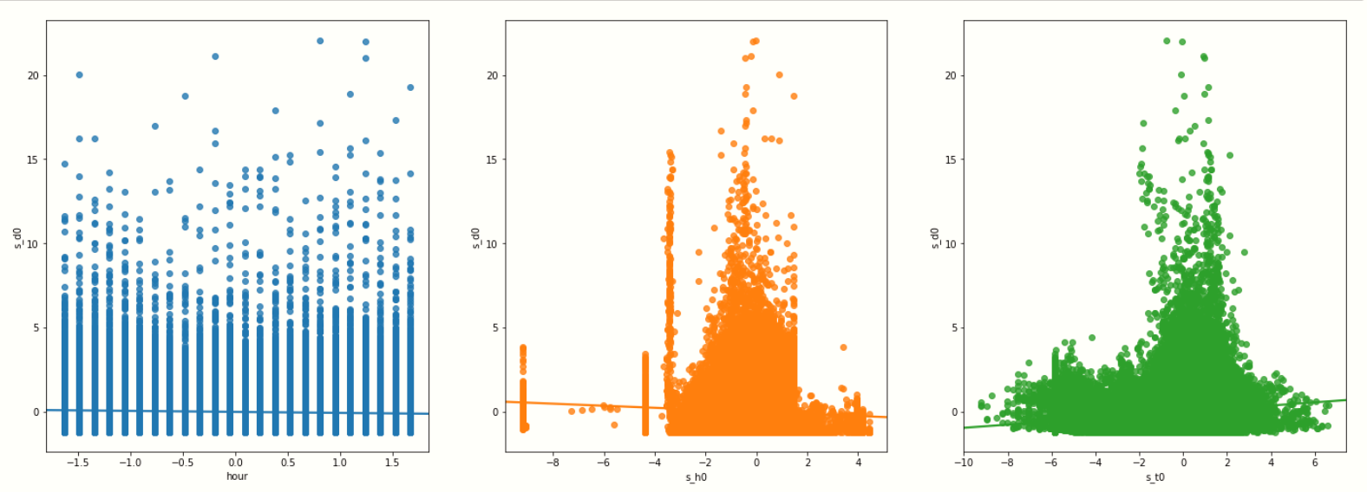
Data visualization

Slide 12
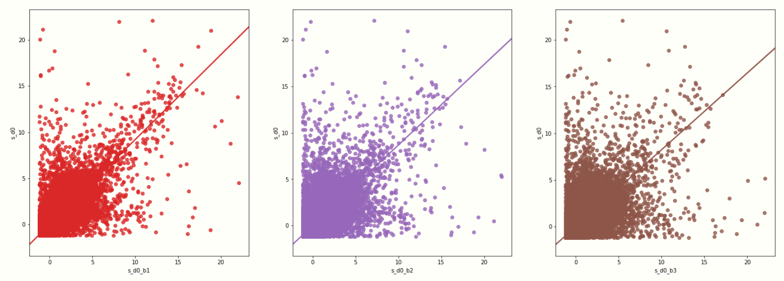
Data visualization (cont.)

Slide 13
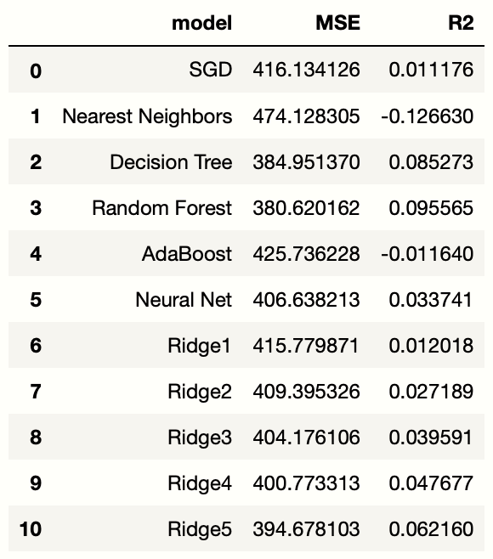
Training Results (bad)
Input features:
hour, humidity, temperature

Slide 14
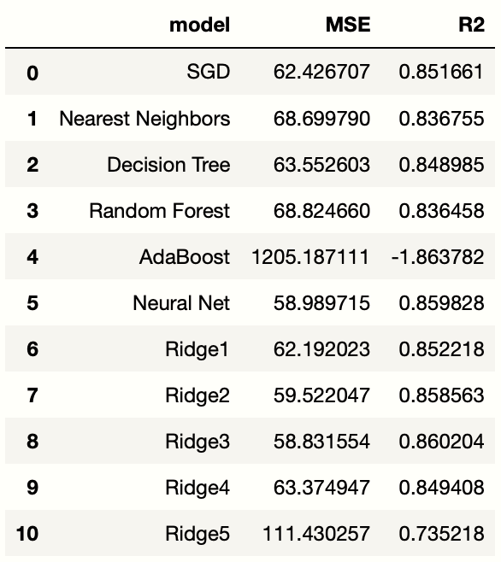
Training Results (good)
Input features:
hour, humidity, temperature, s_d0_b1, s_d0_b2, s_d0_b3

Slide 15
Conclusion
Time and weather doesn’t have much apparent relationship with PM2.5
Derivative attributes that we created make data more fit to the regression models

Slide 16
THANK YOU !

